Slide 1
Introduction to R
Katherine Tansey, PhD

Slide 2
Learning Objectives
Get familiar and comfortable with RStudio and Rmarkdown
Understand the basic syntax of R
Know the different data types and structures used by R
Learn where to find help

Slide 3
Why R?
Open Source
More than 5,000 publicly released R packages
You too can write and release an R package
Huge online community
Means you can get help easily!
GREAT for statistical analysis
EXCELLENT for making plots
Integrates well with other computer languages (C++, Java, C)

Slide 4
Introduction to Basics

Slide 5
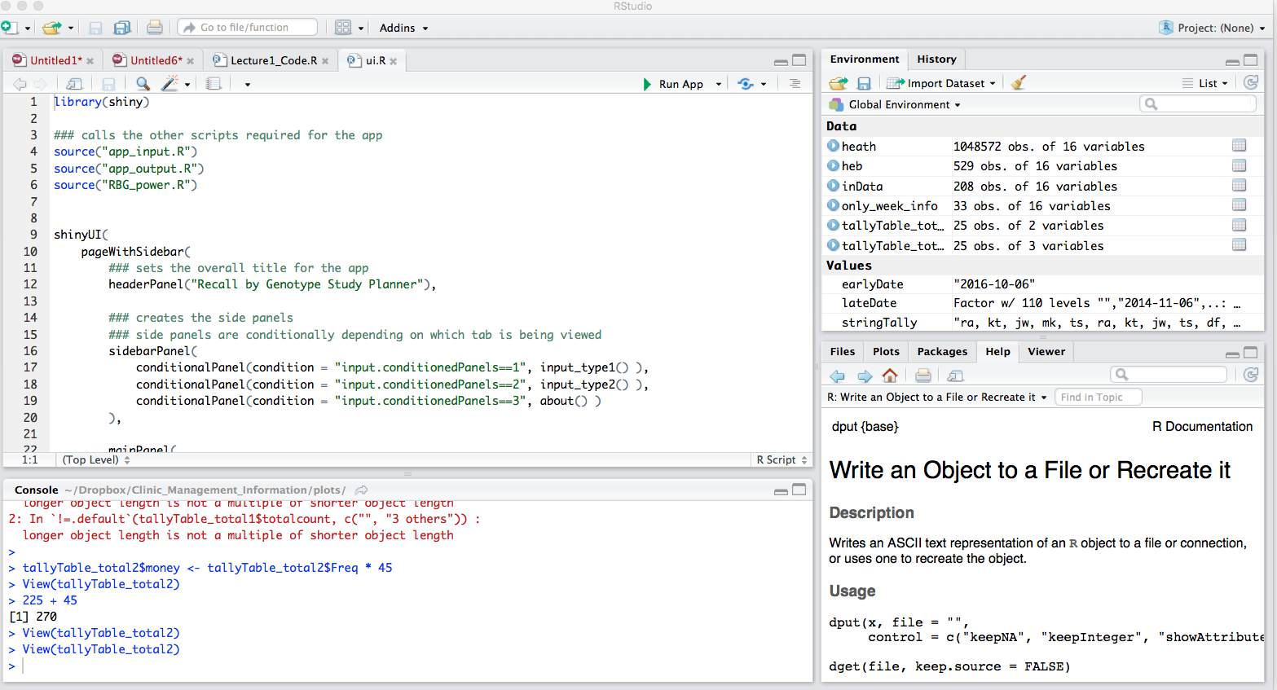
R Studio
Code Editor
Workspace
History
Plots
Files
Help
R Console

Slide 6
Ways to use RStudio
Interactive R console
Test out code in the console and copy it into a file for saving later
Not effective or efficient
Easy to “lose” steps/code by forgetting to copy over key pieces
Write an .R file
Select and run commands from file in the interactive R console
ALL code is saved

Slide 7
R likes math
Addition: +
Subtraction: -
Multiplication: *
Division: /
Exponentiation: ^
Modulo: %%
Trig functions : sin()
Natural log : log()
Base-10 log : log10()
Exponential : exp()

Slide 8
PRACTICAL
Do math

Slide 9
R prompt
>
Prompt
Know R is awaiting input and nothing is currently running
+
R is waiting for you to complete a command
Cancel a command by hitting Esc
Command line R → cancel command with Ctrl+C

Slide 10
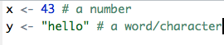
Comments
#
R ignores everything after a #
Use these to make comments in the code

Slide 11
Assigning values to variables
A variable stores a value or an object
Use variable’s name to easily access the value or the object that is stored within this variable
Variable names can not contain spaces or special characters
<- used to assign values to variables
x <- 43
y <- “hello”

Slide 12
PRACTICAL
Assign some stuff to variables

Slide 13
Variable naming
Types of variable naming conventions
this_is_called_snake_case
whileThisIsCamelCase
sometimes.there.be.periods
Or_thereAre.thoseThat_Annoy.everyone
Can not start with a number
Can only contain letters, numbers, ., _

Slide 14
Variable naming
Best practice:
Make the variable names meaningful
Do not make them too long

Slide 15
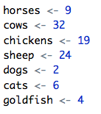
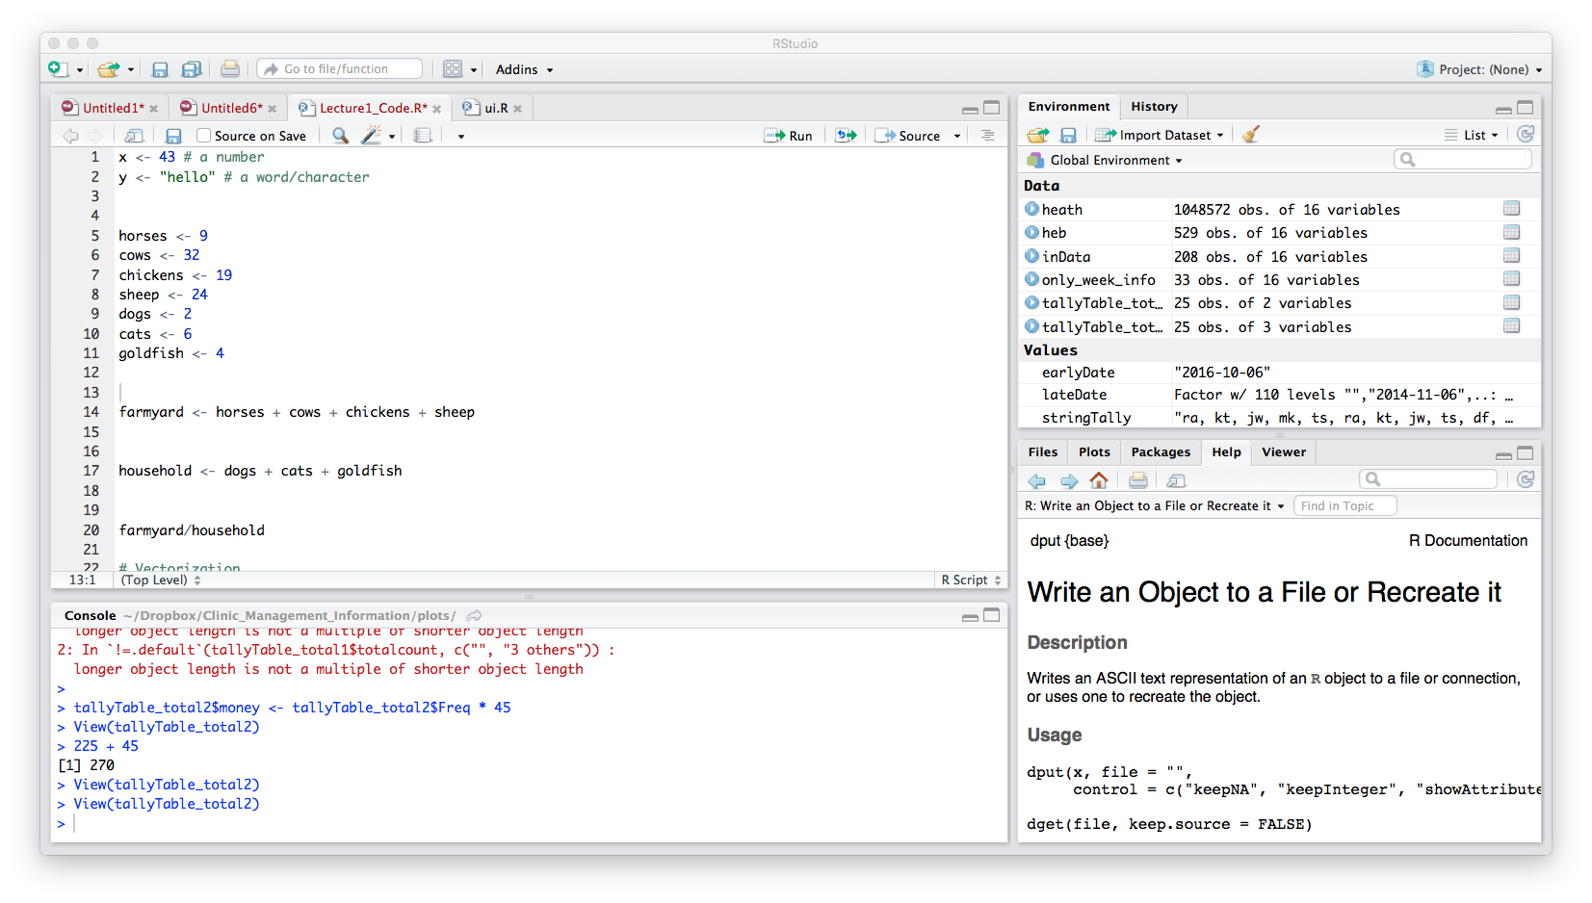
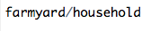
Variables can be used like values
How many farmyard animals are there?
How many house pets are there?
Ratio of farmyard animals to house pets

Slide 16
Displaying values of variables
2 ways to do this:
Type variable name into R console
Use print() function

Slide 17
PRACTICAL
Print values to console

Slide 18
Tab completion!
RStudio will tab complete previously defined variable names
Very handy!
Particularly for longer variable names
Or complicated names
Because harder to get wrong if R is helping you complete the name
Remember with computers: You MUAT ALWAYS be completely precise in your instructions

Slide 19
Data Types
x <- 43
y <- “hello”
43 and “hello” are not treated the same by R
Variables inherit their type from what they contain
Use class() to see a variables types
Data Type | Example
Numeric | 1000.4, 85.6 (numbers with decimals)
Character | “hello”, “23.4”, “True”, “a”
Integer | 3L, 42L, 0L (natural numbers)
Logical | TRUE, FALSE

Slide 20
Project management

Slide 21
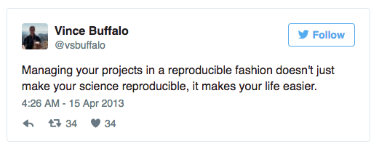
Project management
A good project management will ultimately make your life easier:
Help ensure data integrity
Makes it simpler to share code
Easily upload code with manuscript submission
Easier to pick the project back up after a break

Slide 22
PRACTICAL Use RStudio to Project Manage
Create a new project in RStudio:
Click the “File” menu button, then “New Project”
Click “New Directory”
Click “Empty Project”
Type in the name of the directory to store the projectMake sure that the checkbox for “Create a git repository” is selected
Click the “Create Project” button

Slide 23
Best Practice for project management
Treat data as read-only
Original data is always left in an untouched state
Treat generated output as disposable
All outputs should be able to be regenerated from scripts
Separate function definition and application
Reusable chunks get pulled into their own functions
Separate these into separate folders
Useful functions reused across analyses and projects
Analysis scripts

Slide 24
Structure
my_project
bin/ input/ output/ doc/ qc/ resources/ src/
Put each project in its own directory
Named after the project!
Text documents associated with the project in the doc directory
Raw data and metadata in the input directory
Files generated during cleanup and analysis in a output directory
Source for the project’s scripts and programs in the src directory
Programs brought in from elsewhere or compiled locally in the bin directory.
Name all files to reflect their content or function
This is flexible – but best to GET ORGANIZED

Slide 25
REMEMBER
Do not use spaces, quotes, special characters, or wildcard characters such as ‘*’ or ‘?’ in filenames, as it complicates variable expansion.
Give files consistent names that make logical sense, reflect what the data is and that are easy to match with wildcard patterns to make it easy to select them for looping.
THIS IS THE SAME AS WHEN WE TALK ABOUT UNIX!!!!

Slide 26
Git integration
RStudio connects to git
Very limited in what it can do
Might have to also access git via Unix

Slide 27
Using Markdown

Slide 28
Why?
Supplement R code with narration
Comments!!!
Fully reproducible
Integrate in UNIX (Bash), Python, SQL, and more
Output in various formats (HTML, PDF, Word, SlideShows)
Links easily with Shiny

Slide 29
Markdown
Plain text
Simple formatting
Use instructions to build HTML, PDF or Word documents
Need to learn simple formatting
Reference guide: http://www.rstudio.com/wp-content/uploads/2015/03/rmarkdown-reference.pdf

Slide 30
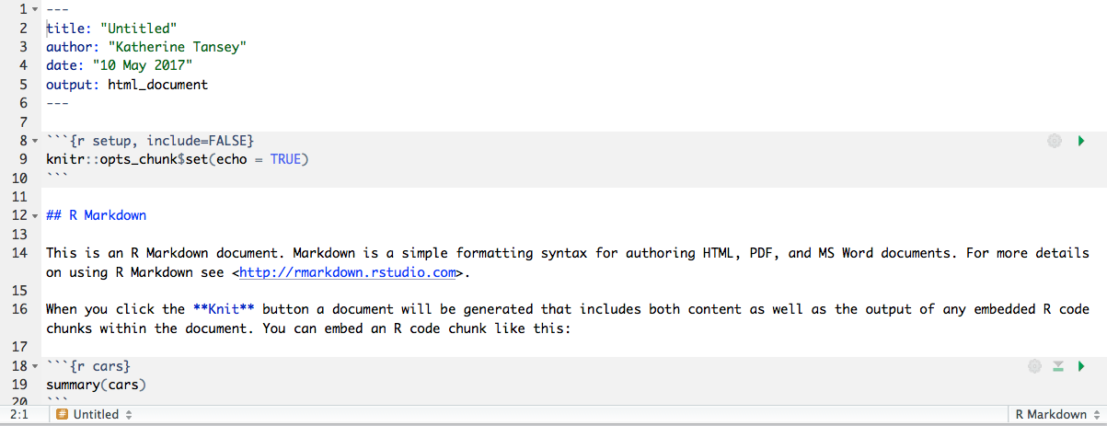
Let’s look at a Markdown file
YAML header with some metadata
R code
chunks
Narrative
Text
R code
chunks

Slide 31
PRACTICAL
Examine Markdown HTML file and Rmd to compare

Slide 32
Basics to Markdown
# First level header
## Second level header
### Third level header
*italics*
**bold**
`code`
[RStudio](www.rstudio.com)

Slide 33
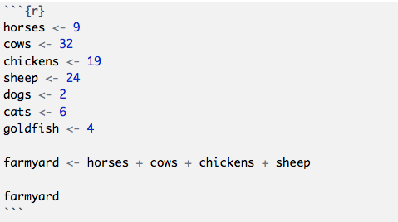
R code chunks
Code chunk options:
warning == FALSE → don’t output warnings
message == FALSE → don’t output messages
error == FALSE → don’t output error reporting
echo == FALSE → don’t output R code in document
Common for when making plots
eval == FALSE → don’t run the code or include its results
results == ‘hide’ → don’t display results of the code
fig.height == ## → set a height for a plot
fig.width == ## → set a width for a plot

Slide 34
PRACTICAL
Altering a markdown file

Slide 35
From here forward
Everything you do should be written in Markdown
The practicals are written in markdown!
Write yourselves comments in the plain text to describe what we are doing and why
Your assignments for this module with have to be done in Markdown

Slide 36
Getting help

Slide 37
Getting help in R
? before function name
?mean
Documentation on how to use the mean function
??function_name
When you don’t completely remember the function name
help()
help(mean)
Documentation on how to use the mean function
Both get you the same documentation
NOT always very helpful

Slide 38
The internet is your friend
Quick-R : http://www.statmethods.net/
Cookbook for R : http://www.cookbook-r.com/
R-bloggers : https://www.r-bloggers.com/
Stackoverflow : http://stackoverflow.com/tags/r/info
CrossValidated : https://stats.stackexchange.com/
Google

Slide 39
Data structures

Slide 40
Data structures
Vector
Data Frame
Factor
Not going to go over but read about them for self directed learning
Matrix
Tables
List

Slide 41
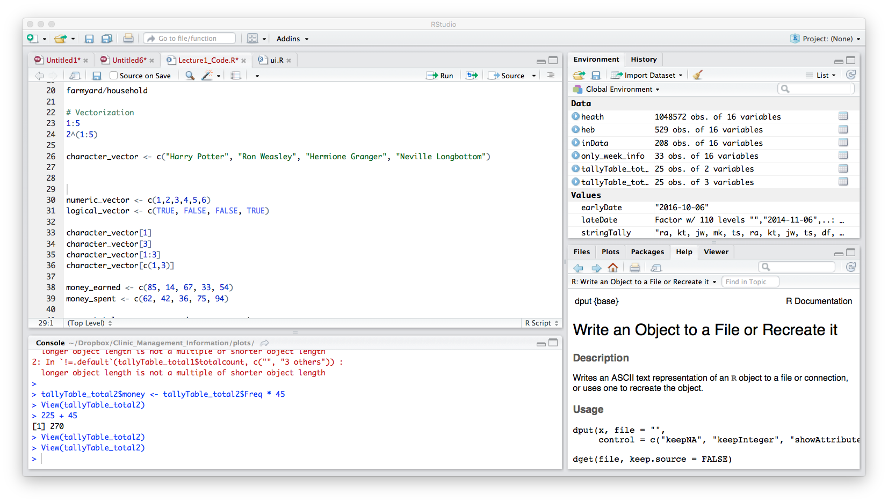
Vectors
R counts from 1
Collections of values of the same type
One-dimensional arrays
c() ➔ combine values into a vector
Retrieve individual elements from a vector
character_vector[1] → “Harry Potter”
character_vector[3] → “Hermione Granger”
character_vector[1:3] →
character_vector[c(1,3)] →

Slide 42
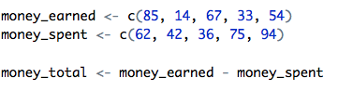
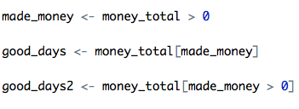
Math with numeric vectors
Addition (+), subtraction (-), multiplication (*), division (/)
Selection

Slide 43
PRACTICAL
Play with vectors

Slide 44
Factor
Stores categorical data
Sex <- c(“Female”, “Male”)
factor() ➔ function to encode a vector as a factor
Can be ordered (ordinal data)

Slide 45
PRACTICAL
Factors

Slide 46
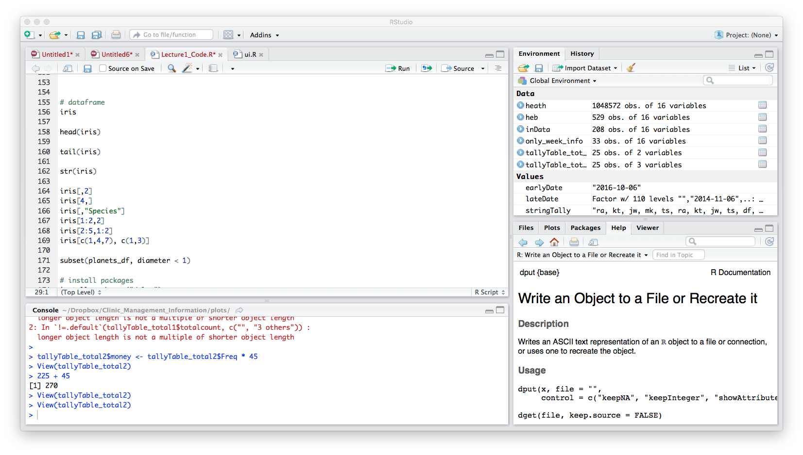
Data Frame
Variables of a data set as columns and the observations as rows
Two-dimensional array
Similar to a matrix
Each column can have a different data type
data.frame()➔ function to make dataframe
str() ➔ structure of data set

Slide 47
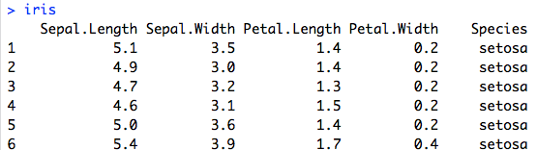
Data Frame
R counts from 1
Retrieve elements from a dataframe
iris[,2]
iris[4,]
iris[,“Species”]
iris$Species
iris[1:2,2]
iris[2:5,1:2]
iris[c(1,4,7), c(1,3)]

Slide 48
PRACTICAL
Data frames

Slide 49
Dataframe size
nrow()
Number of rows in the dataframe
dim()
Number of dimensions
Columns and rows
colnames()
Gets the column names of the dataframe

Slide 50
PRACTICAL
Data frames

Slide 51
Utilities

Slide 52
Useful built in functions
Don’t re-invent the wheel
Use the built-in functions
Built-in functions are written in C and are very fast
Faster than R
There are loads
http://www.statmethods.net/management/functions.html

Slide 53
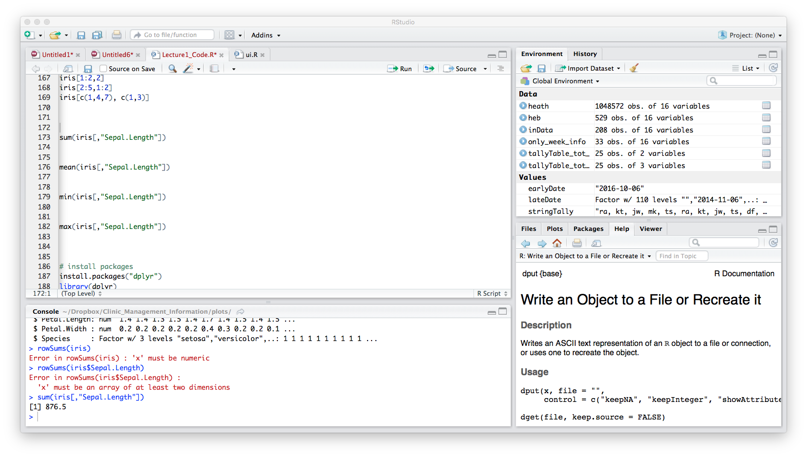
Sum, average, min, max
Sum of the column Sepal.Length
Average of the column Sepal.Length
Minimum value in column Sepal.Length
Maximum value in column Sepal.Length

Slide 54
PRACTICAL
Play with built in functions

Slide 55
Wrapping Up

Slide 56
A lot covered
Use Rstudio
Markdown, project management, git!
Data Structures and Data Types
Vectors and Dataframes
Getting help

Slide 57
Key points
R has the usual arithmetic operators and mathematical functions
<- assign values to variables
Treat raw data as read-only
Treat generated output as disposable
Separate function definition and application
Use R built-in functions – they are fast

Slide 58
REMEMBER
Do not use spaces, quotes, special characters, or wildcard characters such as ‘*’ or ‘?’ in filenames, as it complicates variable expansion.
Give files consistent names that make logical sense, reflect what the data is and that are easy to match with wildcard patterns to make it easy to select them for looping.
THIS IS THE SAME AS WHEN WE TALK ABOUT UNIX!!!!

Slide 59
Self Directed Learning
Data Structures
Matrix, Tables, List
Further Reading
Hadley Wickham’s Advanced R
Data structures : http://adv-r.had.co.nz/Data-structures.html
Style : http://adv-r.had.co.nz/Style.html
Subsetting : http://adv-r.had.co.nz/Subsetting.html

Slide 60
CHEAT SHEETS!
RStudio : https://www.rstudio.com/wp-content/uploads/2016/01/rstudio-IDE-cheatsheet.pdf
R Markdown : https://www.rstudio.com/wp-content/uploads/2016/03/rmarkdown-cheatsheet-2.0.pdf
R Markdown Reference Guide : https://www.rstudio.com/wp-content/uploads/2015/03/rmarkdown-reference.pdf
Data Import : https://github.com/rstudio/cheatsheets/raw/master/source/pdfs/data-import-cheatsheet.pdf

Slide 61
Citation
Software Carpentry : https://software-carpentry.org/lessons/

